Slide 1

Graph Neural Network and Reinforcement Learning in EDA and beyond
Callie Hao
Assistant Professor
ECE, Georgia Institute of Technology
Sharc-lab @ Georgia Tech https://sharclab.ece.gatech.edu/

Slide 2
Outline
Background
Graph Neural Network (GNN)
Reinforcement Learning (RL)
High Level Synthesis (HLS)
HLS: Program-to-Circuit
IRONMAN: GNN-assisted design space exploration in high-level synthesis via reinforcement learning
Nan Wu, Yuan Xie, and Cong Hao, GLSVLSI, 2021
Program-to-Circuit: Exploiting GNNs for Program Representation and Circuit Translation
Nan Wu, Huake He, Yuan Xie, Pan Li, Cong Hao, arXiv, 2021
And beyond: Program-to-X
Call for future research interests ☺

Slide 3




Acknowledgement
Nan Wu
University of California, Santa Barbara
Yuan Xie
University of California, Santa Barbara
Pan Li
Purdue University
… and myself
(Just to fill up the space)

Slide 4
Outline
Background
Graph Neural Network (GNN)
Reinforcement Learning (RL)
High Level Synthesis (HLS)
HLS: Program-to-Circuit
IRONMAN: GNN-assisted design space exploration in high-level synthesis via reinforcement learning
Nan Wu, Yuan Xie, and Cong Hao, GLSVLSI, 2021
Program-to-Circuit: Exploiting GNNs for Program Representation and Circuit Translation
Nan Wu, Huake He, Yuan Xie, Pan Li, Cong Hao, arXiv, 2021
And beyond: Program-to-X
Call for future research interests ☺

Slide 5

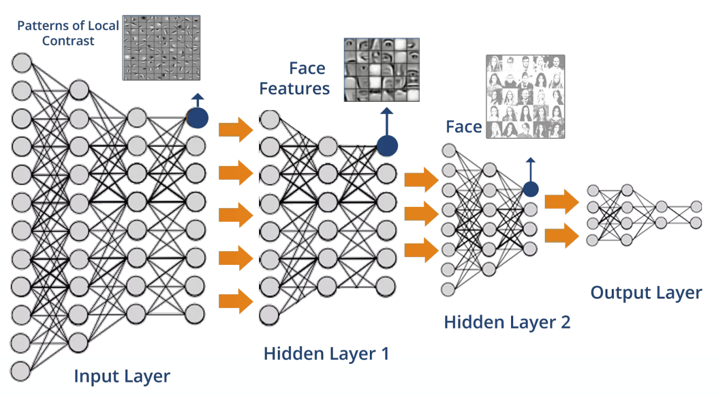
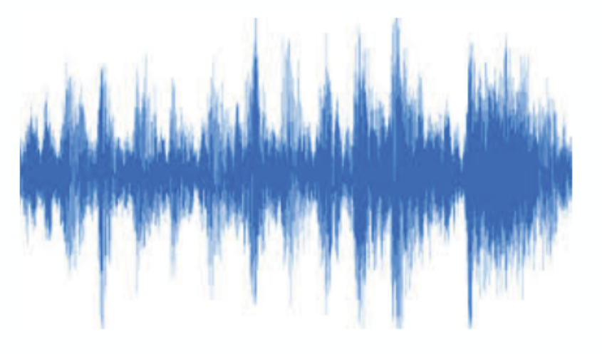
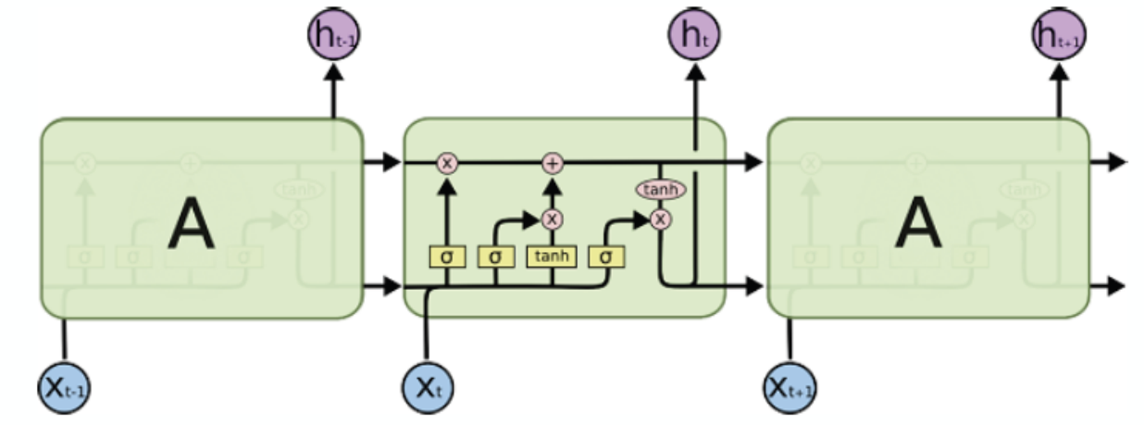
What is Graph Neural Network (GNN)
Traditional neural networks are designed for simple sequences & grids
Speech/Text
[Slide credit: http://web.stanford.edu/class/cs224w]

Slide 6

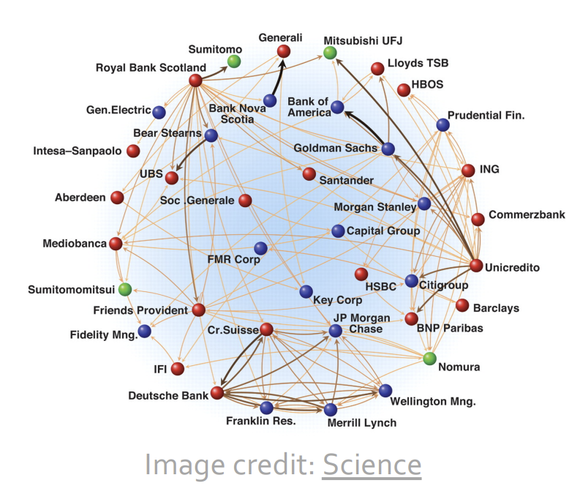
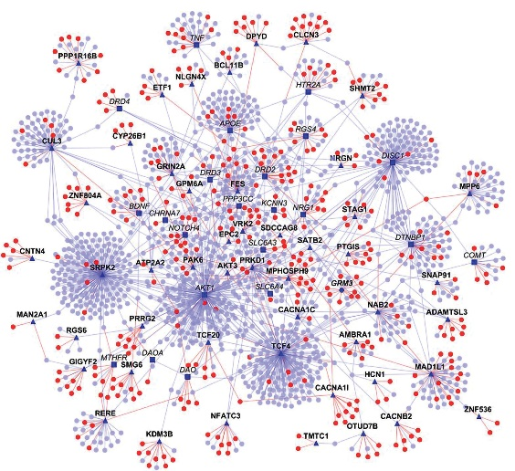
What is Graph Neural Network (GNN)
Reality: A lot of real-world data does not “live” on grids
Arbitrary size and complex topological structure
No fixed node ordering or reference point
Often dynamic and have multimodal features
Image credit: Madhavicmu / Wikimedia Commons/CC-BY-SA-4.0
Social Networks
Economic Networks
Protein Interaction Networks

Slide 7
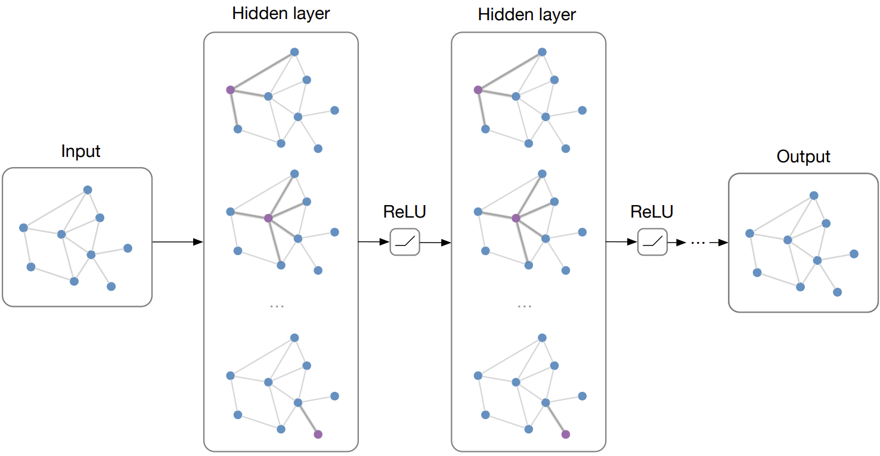
What is Graph Neural Network (GNN)
Main Idea: Pass massages between pairs of nodes and agglomerate
[Slide credit: Structured deep models: Deep learning on graphs and beyond]

Slide 8
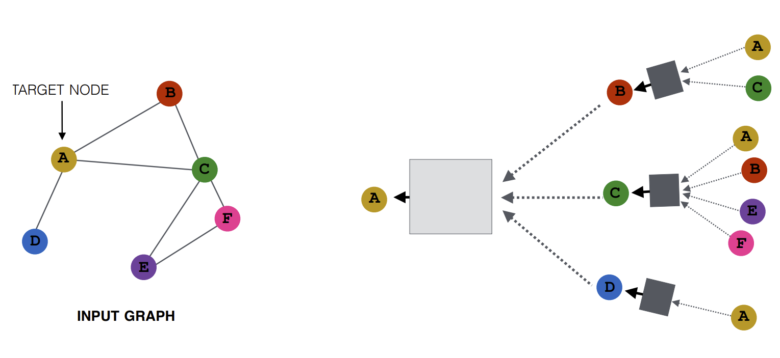
How is GNN Computed (e.g., GCN)
Key idea: Generate node embeddings based on local network neighborhoods
Node embedding: a vector to represent the node features
MLP
MLP
MLP
MLP
[Slide credit: http://web.stanford.edu/class/cs224w]

Slide 9
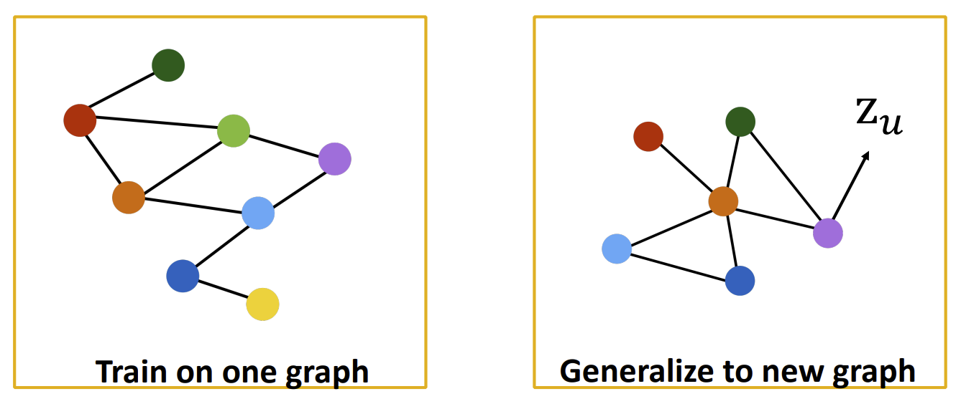
Inductive Capability of GNNs
Model parameters are shared for all nodes
Model can generalize to unseen nodes and entirely unseen graphs
[Slide credit: http://web.stanford.edu/class/cs224w]

Slide 10
Outline
Background
Graph Neural Network (GNN)
Reinforcement Learning (RL)
High Level Synthesis (HLS)
HLS: Program-to-Circuit
IRONMAN: GNN-assisted design space exploration in high-level synthesis via reinforcement learning
Nan Wu, Yuan Xie, and Cong Hao, GLSVLSI, 2021
Program-to-Circuit: Exploiting GNNs for Program Representation and Circuit Translation
Nan Wu, Huake He, Yuan Xie, Pan Li, Cong Hao, arXiv, 2021
And beyond: Program-to-X
Call for future research interests ☺

Slide 11
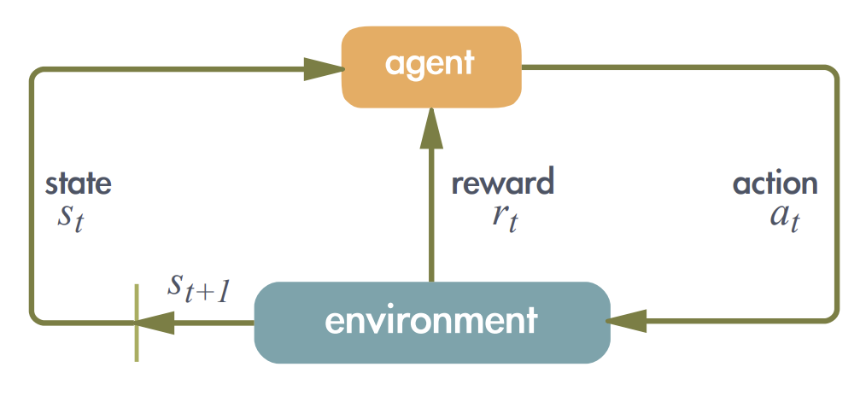
What is Reinforcement Learning (RL)
An agent learns in an interactive environment by trial and error using feedback from its own actions and experiences
Suitable to handle control problems or sequential decision-making processes
Can explore design space proactively and intelligently
Agent behaviors are optimized by embedding optimization goals into reward functions
[Slide credit: https://arxiv.org/pdf/2102.07952.pdf]

Slide 12
Outline
Background
Graph Neural Network (GNN)
Reinforcement Learning (RL)
High Level Synthesis (HLS)
HLS: Program-to-Circuit
IRONMAN: GNN-assisted design space exploration in high-level synthesis via reinforcement learning
Nan Wu, Yuan Xie, and Cong Hao, GLSVLSI, 2021
Program-to-Circuit: Exploiting GNNs for Program Representation and Circuit Translation
Nan Wu, Huake He, Yuan Xie, Pan Li, Cong Hao, arXiv, 2021
And beyond: Program-to-X
Call for future research interests ☺

Slide 13


What is High Level Synthesis (HLS)
for (i=1; i<=c;)
a = a++;
b = x*2-a;
a = y+b/3;
for (i=1; i<=c;)
a = a++;
b = x*2-a;
a = y+b/3;
+
REG
for (i=1; i<=c;)
a = a++;
b = x*2-a;
a = y+b/3;
+
out
HLS Tools
+
REG
REG
High-Level Synthesis
Software Specification and Program
*
*
in
in
*
in
Logic Synthesis
C / C++, Chisel, …
Verilog, VHDL, …
Physical Synthesis
Circuit (ASIC, FPGA) Design

Slide 14
What is High Level Synthesis (HLS)
for (i=1; i<=c;)
a = a++;
b = x*2-a;
a = y+b/3;
for (i=1; i<=c;)
a = a++;
b = x*2-a;
a = y+b/3;
+
REG
for (i=1; i<=c;)
a = a++;
b = x*2-a;
a = y+b/3;
+
out
HLS Tools
+
REG
REG
High-Level Synthesis
Software Specification and Program
*
*
in
in
*
in
Logic Synthesis
C / C++, Chisel, …
Verilog, VHDL, …
Physical Synthesis
Why HLS?
Easy programming: C/C++/Python v.s. Verilog
Fast → productivity
Promote device usage
More optimization opportunities at higher level
Circuit (ASIC, FPGA) Design

Slide 15
Outline
Background
Graph Neural Network (GNN)
Reinforcement Learning (RL)
High Level Synthesis (HLS)
HLS: Program-to-Circuit
IRONMAN: GNN-assisted design space exploration in high-level synthesis via reinforcement learning
Nan Wu, Yuan Xie, and Cong Hao, GLSVLSI, 2021
Program-to-Circuit: Exploiting GNNs for Program Representation and Circuit Translation
Nan Wu, Huake He, Yuan Xie, Pan Li, Cong Hao, arXiv, 2021
And beyond: Program-to-X
Call for future research interests ☺

Slide 16
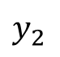
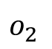
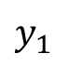
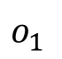
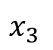
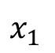
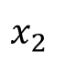
HLS: Program-to-Circuit
Programs are translated to Data Flow Graphs (DFGs) as the Intermediate Representation (IR)
Techniques applied to DFGs: operation scheduling, resource allocation, resource binding, etc.
Finally translated to register-transfer level (RTL) Circuit
x1 = a + b;
x2 = b + c;
x3 = d * e;
y1 = x1 * x2;
y2 = x2 * x3;
o1 = y1 + 5;
o2 = y1 * y2;
+
+
*
$$x_{1}$$
$$x_{2}$$
$$x_{3}$$
REG
REG
*
*
$$y_{1}$$
$$y_{2}$$
ADD
MUL
+
*
REG
REG
$$o_{1}$$
$$o_{2}$$
Program
Data Flow Graph (DFG)
RTL (Circuit)

Slide 17
HLS: Program-to-Circuit Challenges
1
Hard-to-predict RTL circuit quality
2
Multi-objective trade-offs
3
Manual code transformation
Program-to-Circuit
x1 = a + b;
x2 = b + c;
x3 = d * e;
y1 = x1 * x2;
y2 = x2 * x3;
o1 = y1 + 5;
o2 = y1 * y2;
+
+
*
$$x_{1}$$
$$x_{2}$$
$$x_{3}$$
REG
REG
*
*
$$y_{1}$$
$$y_{2}$$
ADD
MUL
+
*
REG
REG
$$o_{1}$$
$$o_{2}$$
Program
Data Flow Graph (DFG)
RTL (Circuit)

Slide 18



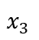
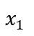
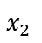
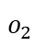
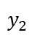
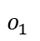
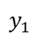
Challenge 1: Hard-to-predict RTL Quality
Getting actual circuit quality after implementation is very time-consuming
E.g,. resource usage, critical path timing
How about quality prediction?
x1 = a + b;
x2 = b + c;
x3 = d * e;
y1 = x1 * x2;
y2 = x2 * x3;
o1 = y1 + 5;
o2 = y1 * y2;
A few Seconds
+
+
*
Minutes to hours
Hours to days…
$$x_{1}$$
$$x_{3}$$
REG
REG
$$x_{2}$$
*
*
$$y_{1}$$
$$y_{2}$$
ADD
MUL
+
*
$$o_{1}$$
$$o_{2}$$
REG
REG
Actual Implementation
Program
Data Flow Graph (DFG)
RTL (Circuit)

Slide 19
Challenge 1: Hard-to-predict RTL Quality
Getting actual circuit quality after implementation is very time-consuming
E.g,. resource usage, critical path timing
How about quality prediction?
RTL design quality is hard to predict, especially for irregular data paths
Existing HLS tools’ estimation sometimes can be far from accurate
Analytical-model-based predictors only work for well-structured data flows
ML-based predictors requires abundant features after design synthesis and/or implementation
x1 = a + b;
x2 = b + c;
x3 = d * e;
y1 = x1 * x2;
y2 = x2 * x3;
o1 = y1 + 5;
o2 = y1 * y2;
A few Seconds
+
+
*
Minutes to hours
Hours to days…
$$x_{1}$$
$$x_{3}$$
REG
REG
$$x_{2}$$
*
*
$$y_{1}$$
$$y_{2}$$
ADD
MUL
+
*
$$o_{1}$$
$$o_{2}$$
REG
REG
Actual Implementation
Program
Data Flow Graph (DFG)
RTL (Circuit)

Slide 20
Motivation 1: Predict Impl. Quality Accurately
Extract the DFG…
… and predict the implementation quality accurately
x1 = a + b;
x2 = b + c;
x3 = d * e;
y1 = x1 * x2;
y2 = x2 * x3;
o1 = y1 + 5;
o2 = y1 * y2;
A few Seconds
+
+
*
Minutes to hours
Hours to days…
$$x_{1}$$
$$x_{3}$$
REG
REG
$$x_{2}$$
*
*
$$y_{1}$$
$$y_{2}$$
ADD
MUL
+
*
$$o_{1}$$
$$o_{2}$$
REG
REG
Actual Implementation
Program
Data Flow Graph (DFG)
RTL (Circuit)

Slide 21
Solution 1: Use Graph Neural Network (GNN)
Use Graph Neural Networks!
…and they can generalize to unseen programs!
Extract the DFG…
… and predict the implementation quality accurately
x1 = a + b;
x2 = b + c;
x3 = d * e;
y1 = x1 * x2;
y2 = x2 * x3;
o1 = y1 + 5;
o2 = y1 * y2;
A few Seconds
+
+
*
Minutes to hours
Hours to days…
$$x_{1}$$
$$x_{3}$$
REG
REG
$$x_{2}$$
*
*
$$y_{1}$$
$$y_{2}$$
ADD
MUL
+
*
$$o_{1}$$
$$o_{2}$$
REG
REG
Actual Implementation
Program
Data Flow Graph (DFG)
RTL (Circuit)

Slide 22


HLS: Program-to-Circuit Challenges
1
Hard-to-predict RTL circuit quality
2
Multi-objective trade-offs
3
Manual code transformation
Program-to-Circuit
x1 = a + b;
x2 = b + c;
x3 = d * e;
y1 = x1 * x2;
y2 = x2 * x3;
o1 = y1 + 5;
o2 = y1 * y2;
+
+
*
$$x_{1}$$
$$x_{2}$$
$$x_{3}$$
REG
REG
*
*
$$y_{1}$$
$$y_{2}$$
ADD
MUL
+
*
REG
REG
$$o_{1}$$
$$o_{2}$$
Program
Data Flow Graph (DFG)
RTL (Circuit)

Slide 23
Challenge 2: Multi-objective Trade-offs
(Example) Constraints
Number of DSPs on FPGA
(Example) Design Choices
Each multiplication: use DSP or LUTs?
Objectives
Meeting user-specified constraint
Minimize other resources (area)
Optimizing critical path timing (clock frequency)
DSP=2

Slide 24







Challenge 2: Multi-objective Trade-offs
(Example) Constraints
Number of DSPs on FPGA
(Example) Design Choices
Each multiplication: use DSP or LUTs?
Objectives
Meeting user-specified constraint
Minimize other resources (area)
Optimizing critical path timing (clock frequency)
DSP=2
$$×$$
$$×$$
$$×$$
$$×$$
$$+$$
$$+$$
$$+$$
DSP: 4
Latency: 3
(a) HLS default solution
Operations using DSPs
Operations using LUTs

Slide 25







Challenge 2: Multi-objective Trade-offs
(Example) Constraints
Number of DSPs on FPGA
(Example) Design Choices
Each multiplication: use DSP or LUTs?
Objectives
Meeting user-specified constraint
Minimize other resources (area)
Optimizing critical path timing (clock frequency)
DSP=2
$$×$$
$$×$$
$$×$$
$$×$$
$$×$$
$$×$$
$$+$$
$$+$$
$$+$$
$$×$$
$$×$$
$$+$$
DSP: 4
Latency: 3
$$+$$
DSP: 2
Latency: 4
$$+$$
(a) HLS default solution
(b) HLS solution with naïve constraints
Operations using DSPs
Operations using LUTs

Slide 26
Challenge 2: Multi-objective Trade-offs
(Example) Constraints
Number of DSPs on FPGA
(Example) Design Choices
Each multiplication: use DSP or LUTs?
Objectives
Meeting user-specified constraint
Minimize other resources (area)
Optimizing critical path timing (clock frequency)
Sacrificing latency (# of clock cycles)?
DSP=2
$$×$$
$$×$$
$$×$$
$$×$$
$$×$$
$$×$$
$$+$$
$$+$$
$$+$$
$$×$$
$$×$$
$$+$$
DSP: 4
Latency: 3
$$+$$
DSP: 2
Latency: 4
$$+$$
(a) HLS default solution
(b) HLS solution with naïve constraints
Operations using DSPs
Operations using LUTs

Slide 27






Challenge 2: Multi-objective Trade-offs
(Example) Constraints
Number of DSPs on FPGA
(Example) Design Choices
Each multiplication: use DSP or LUTs?
Objectives
Meeting user-specified constraint
Minimize other resources (area)
Optimizing critical path timing (clock frequency)
Sacrificing latency (# of clock cycles)?
DSP=2
$$×$$
$$×$$
$$×$$
$$×$$
$$×$$
$$×$$
$$×$$
$$×$$
$$×$$
$$×$$
$$+$$
$$+$$
$$+$$
$$×$$
$$×$$
$$+$$
$$+$$
$$+$$
DSP: 4
Latency: 3
$$+$$
DSP: 2
Latency: 4
DSP: 2
Latency: 3
$$+$$
$$+$$
(a) HLS default solution
(b) HLS solution with naïve constraints
(c) A better solution
Operations using DSPs
Operations using LUTs

Slide 28






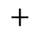



Motivation 2: Automated DSE
Automatically find a best resource allocation that:
Learns to assign resources
Meet user-specified constraints
Trade-off between resource and critical path timing
Do not sacrifice latency
$$×$$
$$×$$
$$×$$
$$×$$
$$×$$
$$×$$
$$×$$
$$×$$
$$×$$
$$×$$
$$×$$
$$×$$
$$+$$
$$+$$
$$+$$
$$+$$
$$+$$
$$+$$
$$+$$
$$+$$
$$+$$
Initial DFG
(c) A better solution

Slide 29
Solution 2: Reinforcement Learning (RL)
Use Reinforcement Learning (RL)!
Use Reinforcement Learning (RL)!
$$×$$
$$×$$
$$×$$
$$×$$
$$×$$
$$×$$
$$×$$
$$×$$
$$×$$
$$×$$
$$×$$
$$×$$
$$+$$
$$+$$
$$+$$
$$+$$
$$+$$
$$+$$
$$+$$
$$+$$
$$+$$
Initial DFG
(c) A better solution

Slide 30
HLS: Program-to-Circuit Challenges
1
Hard-to-predict RTL circuit quality
2
Multi-objective trade-offs
3
Manual code transformation
Program-to-Circuit
x1 = a + b;
x2 = b + c;
x3 = d * e;
y1 = x1 * x2;
y2 = x2 * x3;
o1 = y1 + 5;
o2 = y1 * y2;
+
+
*
$$x_{1}$$
$$x_{2}$$
$$x_{3}$$
REG
REG
*
*
$$y_{1}$$
$$y_{2}$$
ADD
MUL
+
*
REG
REG
$$o_{1}$$
$$o_{2}$$
Program
Data Flow Graph (DFG)
RTL (Circuit)

Slide 31
Challenge 3: Manual Code Transformation
High level abstraction in HLS can conceal optimization opportunities
Structured HLS coding style hinders fine-grained optimization
Loops, function calls, etc.
Irregular logic requires manual or complicated code transformations

Slide 32
Challenge 3: Manual Code Transformation
High level abstraction in HLS can conceal optimization opportunities
Structured HLS coding style hinders fine-grained optimization
Loops, function calls, etc.
Irregular logic requires manual or complicated code transformations
for (int i = 0; i < 8; i++)
{
sum += a[i] * b[i];
}
HLS Method | Cycles | DSP | LUTs | CP (ns)
Original | 17 | 1 | 75 | 4.07
Unroll (factor=8, complete) | 2 | 8 | 100 | 5.04
Unroll (factor=4) | 4 | 4 | 87 | 4.83
Unroll (factor=3) | 8 | 3 | 109 | 7.44
Unroll + allocation (limit=3) | 4 | 6 | 168 | 8.76
If DSP constraint is 3?
The best we can get: DSP = 3, Cycles = 8

Slide 33
Challenge 3: Manual Code Transformation
High level abstraction in HLS can conceal optimization opportunities
Structured HLS coding style hinders fine-grained optimization
Loops, function calls, etc.
Irregular logic requires manual or complicated code transformations
for (int i = 0; i < 8; i++)
{
sum += a[i] * b[i];
}
HLS Method | Cycles | DSP | LUTs | CP (ns)
Original | 17 | 1 | 75 | 4.07
Unroll (factor=8, complete) | 2 | 8 | 100 | 5.04
Unroll (factor=4) | 4 | 4 | 87 | 4.83
Unroll (factor=3) | 8 | 3 | 109 | 7.44
Unroll + allocation (limit=3) | 4 | 6 | 168 | 8.76
Code Transformation (CT) | 2 | 8 | 100 | 5.03
If DSP constraint is 3?
int m1 = a[0] * b[0];
int m2 = a[1] * b[1];
…
int m8 = a[7] * b[7];
int m9 = m1 + m2;
…
Transformed Code

Slide 34
Challenge 3: Manual Code Transformation
High level abstraction in HLS can conceal optimization opportunities
Structured HLS coding style hinders fine-grained optimization
Loops, function calls, etc.
Irregular logic requires manual or complicated code transformations
for (int i = 0; i < 8; i++)
{
sum += a[i] * b[i];
}
HLS Method | Cycles | DSP | LUTs | CP (ns)
Original | 17 | 1 | 75 | 4.07
Unroll (factor=8, complete) | 2 | 8 | 100 | 5.04
Unroll (factor=4) | 4 | 4 | 87 | 4.83
Unroll (factor=3) | 8 | 3 | 109 | 7.44
Unroll + allocation (limit=3) | 4 | 6 | 168 | 8.76
Code Transformation (CT) | 2 | 8 | 100 | 5.03
CT + resource (5 Mul_LUT) | 2 | 2 | 1742 | 4.24
CT + resource (4 Mul_LUT) | 2 | 2 | 1741 | 4.01
CT + resource (3 Mul_LUT) | 2 | 3 | 1461 | 3.98
If DSP constraint is 3?
int m1 = a[0] * b[0];
int m2 = a[1] * b[1];
…
int m8 = a[7] * b[7];
int m9 = m1 + m2;
…
The best we can get: DSP = 3, Cycles = 2

Slide 35
Challenge 3: Manual Code Transformation
High level abstraction in HLS can conceal optimization opportunities
Structured HLS coding style hinders fine-grained optimization
Loops, function calls, etc.
Irregular logic requires manual or complicated code transformations
for (int i = 0; i < 8; i++)
{
sum += a[i] * b[i];
}
HLS Method | Cycles | DSP | LUTs | CP (ns)
Original | 17 | 1 | 75 | 4.07
Unroll (factor=8, complete) | 2 | 8 | 100 | 5.04
Unroll (factor=4) | 4 | 4 | 87 | 4.83
Unroll (factor=3) | 8 | 3 | 109 | 7.44
Unroll + allocation (limit=3) | 4 | 6 | 168 | 8.76
Code Transformation (CT) | 2 | 8 | 100 | 5.03
CT + resource (5 Mul_LUT) | 2 | 2 | 1742 | 4.24
CT + resource (4 Mul_LUT) | 2 | 2 | 1741 | 4.01
CT + resource (3 Mul_LUT) | 2 | 3 | 1461 | 3.98
If DSP constraint is 3?
int m1 = a[0] * b[0];
int m2 = a[1] * b[1];
…
int m8 = a[7] * b[7];
int m9 = m1 + m2;
…
The best we can get: DSP = 3, Cycles = 2
v.s.
DSP = 3, Cycles = 8

Slide 36
Challenge 3: Manual Code Transformation
High level abstraction in HLS can conceal optimization opportunities
Structured HLS coding style hinders fine-grained optimization
Loops, function calls, etc.
Irregular logic requires manual or complicated code transformations
for (int i = 0; i < 8; i++)
{
sum += a[i] * b[i];
}
for (int i = 0; i < 17; i++) {
for (int j = i; j < 23; j+=2) {
sum += a[i] * b[j];
}
}
If DSP constraint is 3?
If DSP constraint is 13?

Slide 37
Challenge 3: Manual Code Transformation
High level abstraction in HLS can conceal optimization opportunities
Structured HLS coding style hinders fine-grained optimization
Loops, function calls, etc.
Irregular logic requires manual or complicated code transformations
Motivation: Need better performance and more flexible optimization choices
Solution: Code transformation

Slide 38
Outline
Background
Graph Neural Network (GNN)
Reinforcement Learning (RL)
High Level Synthesis (HLS)
HLS: Program-to-Circuit
IRONMAN: GNN-assisted design space exploration in high-level synthesis via reinforcement learning
Nan Wu, Yuan Xie, and Cong Hao, GLSVLSI, 2021
Program-to-Circuit: Exploiting GNNs for Program Representation and Circuit Translation
Nan Wu, Huake He, Yuan Xie, Pan Li, Cong Hao, arXiv, 2021
And beyond: Program-to-X
Call for future research interests ☺

Slide 39
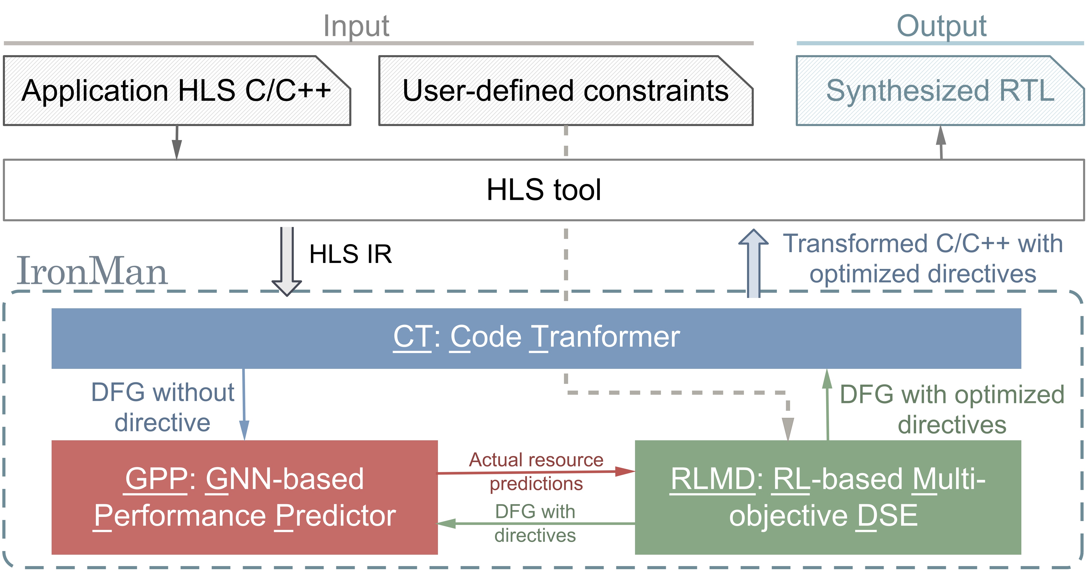
IronMan: GNN + RL for HLS Predict & DSE
IronMan： An end-to-end framework integrating CT, GPP, and RLMD targeting HLS (Program-to-Circuit)
Wu, Nan, Yuan Xie, and Cong Hao. GLSVLSI, 2021

Slide 40
IronMan: GNN + RL for HLS Predict & DSE
Code Transformer (CT) → Challenge 3
Manual CT
Expose more optimization opportunities

Slide 41
IronMan: GNN + RL for HLS Predict & DSE
Code Transformer (CT) → Challenge 3
Manual CT
Expose more optimization opportunities
GPP→Challenge 1
Hard-to-predict RTL Quality
Impl. quality prediction

Slide 42
IronMan: GNN + RL for HLS Predict & DSE
Code Transformer (CT) → Challenge 3
Manual CT
Expose more optimization opportunities
GPP→Challenge 1
Hard-to-predict RTL Quality
Impl. quality prediction
RLMD → Challenge 2
Multi-objective Trade-offs
Automated DSE

Slide 43
IronMan: GNN + RL for HLS Predict & DSE
IRONMAN Goal (a case study):
Find a solution that strictly meets DSP constraints
Find Pareto solutions between DSP and LUT resources on FPGAs, without sacrificing latency

Slide 44
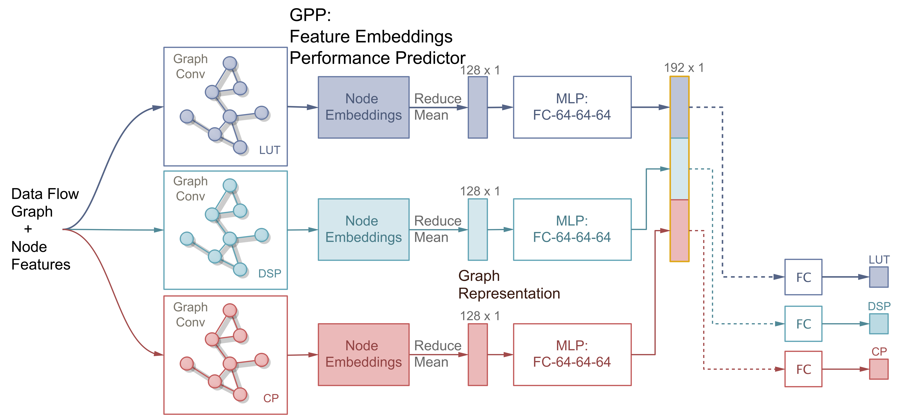
GPP: GNN-based Performance Predictor

Slide 45
GPP: GNN-based Performance Predictor
Generating graph representations

Slide 46
GPP: GNN-based Performance Predictor
3 models of the same structure to separately predict LUT/DSP and CP timing
Generating graph representations
Feed-forward NN

Slide 47
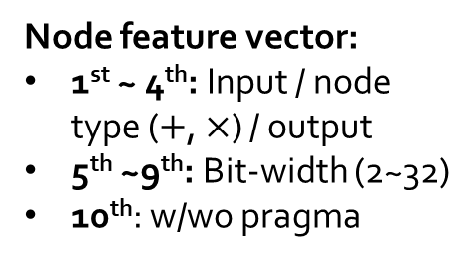
GPP: GNN-based Performance Predictor
3 models of the same structure to separately predict LUT/DSP and CP timing
Node feature vector:
1st ~ 4th: Input / node type ($+$, $×$) / output
5th ~9th: Bit-width (2~32)
10th: w/wo pragma
Generating graph representations
Feed-forward NN

Slide 48
GPP: GNN-based Performance Predictor
Goal of GPP:
Provide graph embeddings of DFGs → generalize across different graphs
Provide high-accuracy performance predictions → quick evaluation of generated solutions and accelerate RL training
3 models of the same structure to separately predict LUT/DSP and CP timing
Node feature vector:
1st ~ 4th: Input / node type ($+$, $×$) / output
5th ~9th: Bit-width (2~32)
10th: w/wo pragma
Generating graph representations
Feed-forward NN

Slide 49
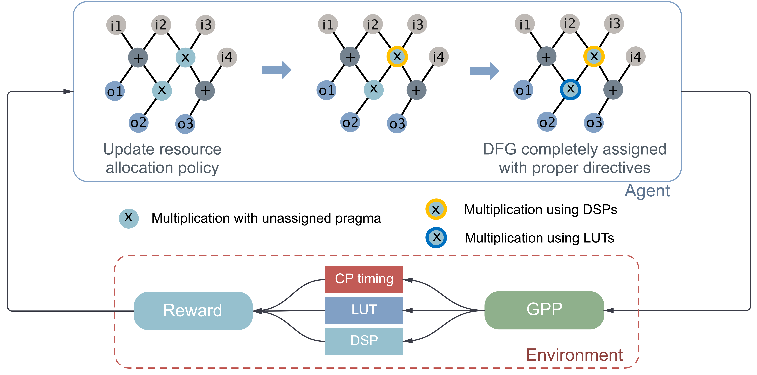
RLMD: RL-based Multi-objective DSE
State: every possible partially assigned DFGs
Action: whether to assign a certain directive to the current node
Reward: a negative weighted sum of predicted resource utilization

Slide 50
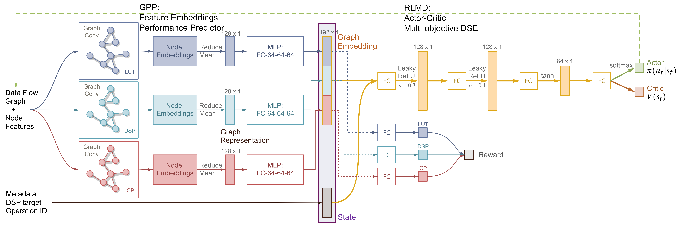
Putting GPP and RLMD Together

Slide 51
Putting GPP and RLMD Together
Two policy optimization methods:
Actor-critic
Policy-gradient

Slide 52
Putting GPP and RLMD Together
Two policy optimization methods:
Actor-critic
Policy-gradient
Actor: Probability distribution on actions
Critic: State-value function
Reward

Slide 53
Experiment Setup
Dataset
Synthetic: 47 different topologies x 100 sets of directives per topology → 4,700 graphs
Real-world: 8 real-case benchmarks x 100 sets of directives per benchmark → 800 graphs
Real applications come from MachSuite, CHStoneand PolyBench/C: gemm, kernel_2mm, kernel_durbin(small,large), spmv, stencil3d(small, large), and kernel_adi
Baselines
Simulated annealing (SA), Genetic algorithm (GA), particle swarm optimization (PSO), Vivado HLS
Training
Trained on 41 different synthetic topologies and 4 real-case benchmarks → 4,500 graphs
Evaluated on the rest of graphs → 1,000 graphs
Evaluation
Ground-truth and solutions are synthesized by Vivado HLS and implemented by Vivado
Actual resource utilization (LUT/DSP) and critical path (CP) timing

Slide 54
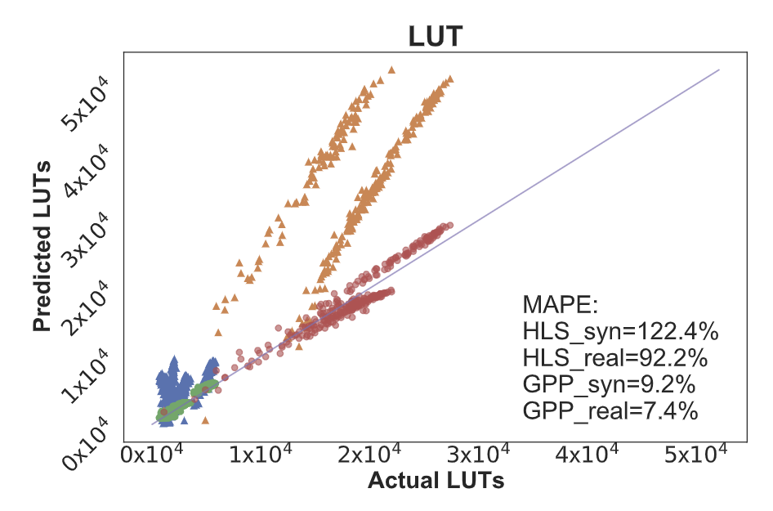
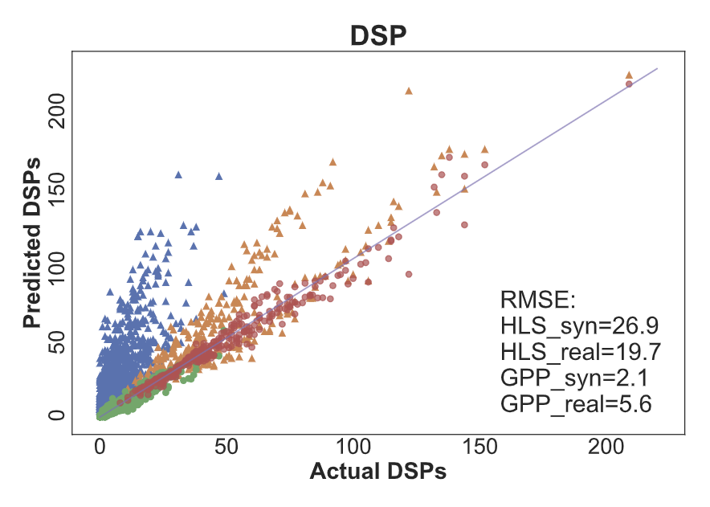
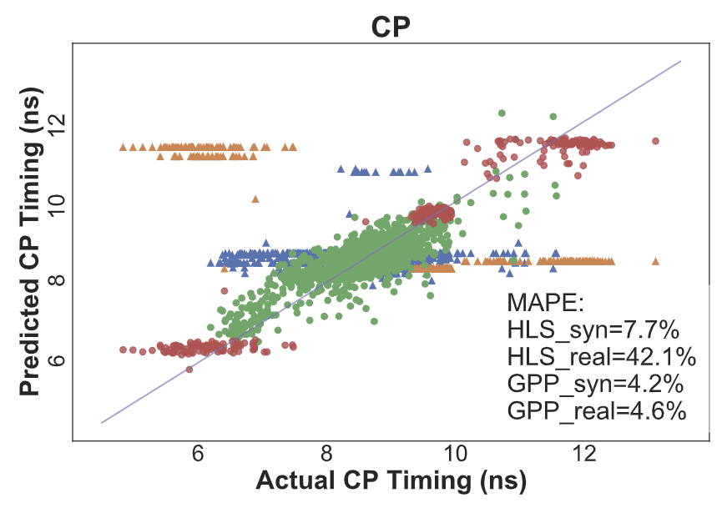
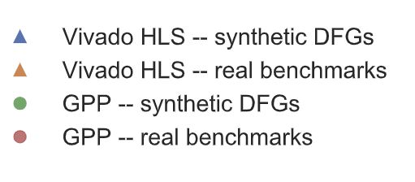
GPP Evaluation: Implementation Prediction
GPP predictions on resource utilization (LUT, DSP), and critical path timing (CP)

Slide 55
GPP Evaluation: Implementation Prediction
HLS
HLS
HLS
GPP
GPP
GPP
GPP predictions on resource utilization (LUT, DSP), and critical path timing (CP)

Slide 56
GPP Evaluation: Implementation Prediction
HLS
HLS
HLS
GPP
GPP
GPP
GPP predictions on resource utilization (LUT, DSP), and critical path timing (CP)
Reduce prediction error of Vivado HLS by 10.9x in resource and 5.7x in timing

Slide 57
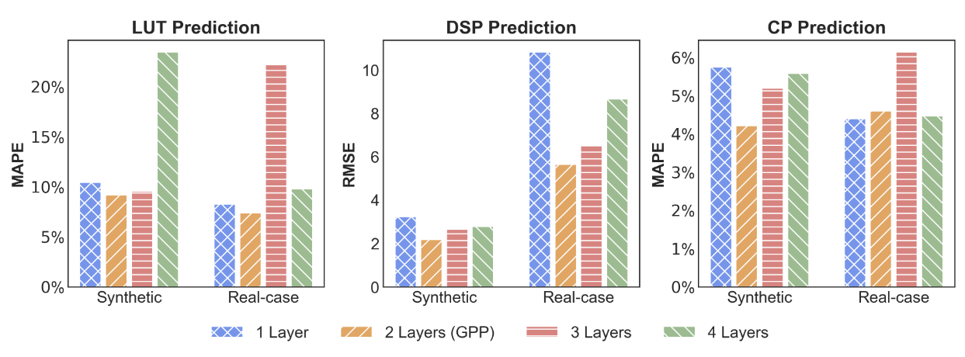

GPP Design Choices

Slide 58
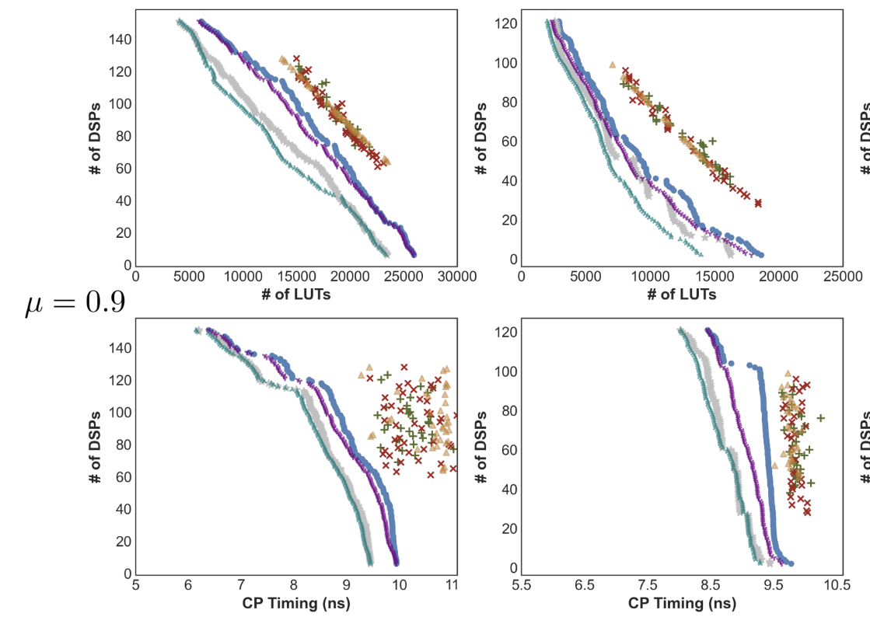
IronMan Evaluation: Pareto Solutions
GEMM
Kernel_2mm
PG with fine-tune
AC with fine-tune
PG
AC
SA/GA/PSO
SA/GA
/PSO
SA/GA
/PSO
Discussions
IronMan outperforms SA/GA/PSO by a large margin (>12.0%)
Fine-tune helps (11.6% additional reduction)
In general policy-gradient outperforms actor-critic
IronMan
IronMan

Slide 59
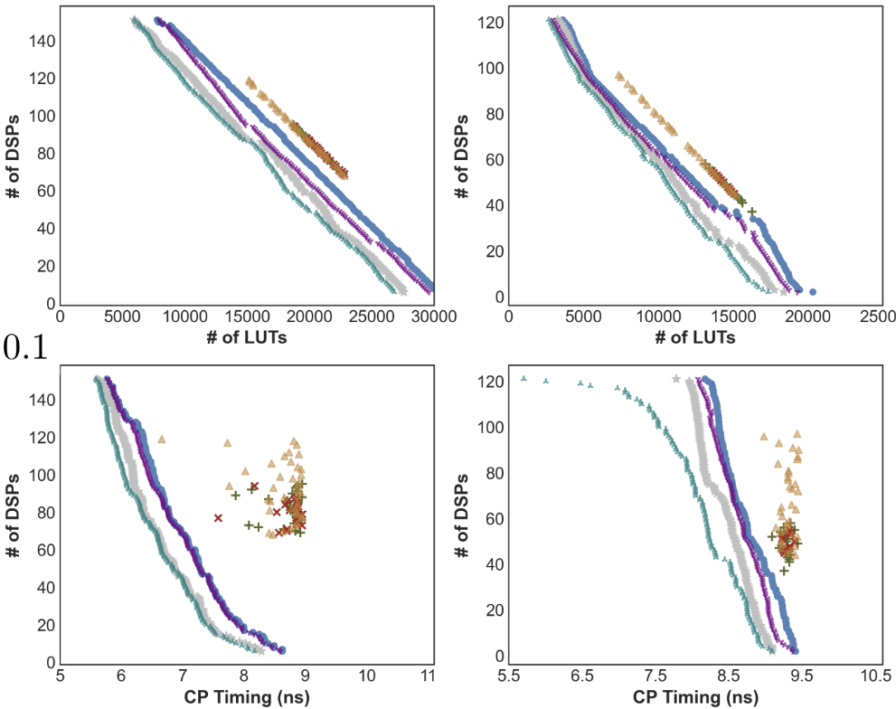
IronMan Evaluation: Multi-objective Opt.
GEMM
Kernel_2mm
GEMM
Kernel_2mm
LUT : CP = 1:9 → Better Timing
LUT : CP = 9:1 → Less LUTs

Slide 60
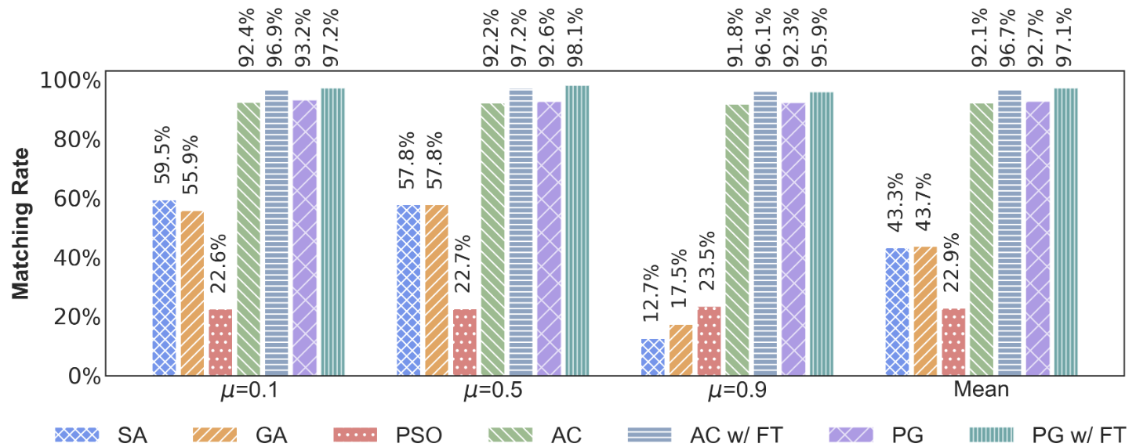
IronMan Evaluation: Meeting Constraints
RLMD meets user-specified constraints (# of DSPs) almost perfectly!

Slide 61
Summary of IronMan
Independently:
GPP achieves high prediction accuracy
RLMD obtains Pareto solutions surpassing GA/SA/PSO
Integrated, IronMan is can:
Help HLS tools generate higher quality solutions under user-specified constraints
Perform flexible DSEs to provide Pareto solutions that are not currently supported by HLS tools
Find solutions perfectly matching various DSP constraints
Execute up to 400X faster than the heuristic algorithms and HLS tools

Slide 62
Outline
Background
Graph Neural Network (GNN)
Reinforcement Learning (RL)
High Level Synthesis (HLS)
HLS: Program-to-Circuit
IRONMAN: GNN-assisted design space exploration in high-level synthesis via reinforcement learning
Nan Wu, Yuan Xie, and Cong Hao, GLSVLSI, 2021
Program-to-Circuit: Exploiting GNNs for Program Representation and Circuit Translation
Nan Wu, Huake He, Yuan Xie, Pan Li, Cong Hao, arXiv, 2021
And beyond: Program-to-X
Call for future research interests ☺

Slide 63
Diving Deeper: Program-to-Circuit
How powerful are GNNs to represent programs and to solve Program-to-Circuit problem?
Extract the DFG…
… and predict the implementation quality accurately
x1 = a + b;
x2 = b + c;
x3 = d * e;
y1 = x1 * x2;
y2 = x2 * x3;
o1 = y1 + 5;
o2 = y1 * y2;
A few Seconds
+
+
*
Minutes to hours
Hours to days…
$$x_{1}$$
$$x_{3}$$
REG
REG
$$x_{2}$$
*
*
$$y_{1}$$
$$y_{2}$$
ADD
MUL
+
*
$$o_{1}$$
$$o_{2}$$
REG
REG
Actual Implementation
Program
Data Flow Graph (DFG)
RTL (Circuit)

Slide 64
From IronMan to Program-to-Circuit
IronMan | Program-to-Circuit
Only MUL and ADD operations | All types of operations: arithmetic computation, memory (load/store), control (loop, branch), etc.
Data Flow Graph (DFG) | Control Data Flow Graph (CDFG)
10 node features (one-hot embedding) | More complex learnable node embeddings
2-layer GCN | 14 types of GNNs
Nan Wu, Huake He, Yuan Xie, Pan Li, Cong Hao, “Program-to-Circuit: Exploiting GNNs for Program Representation and Circuit Translation”, arXiv, 2021

Slide 65
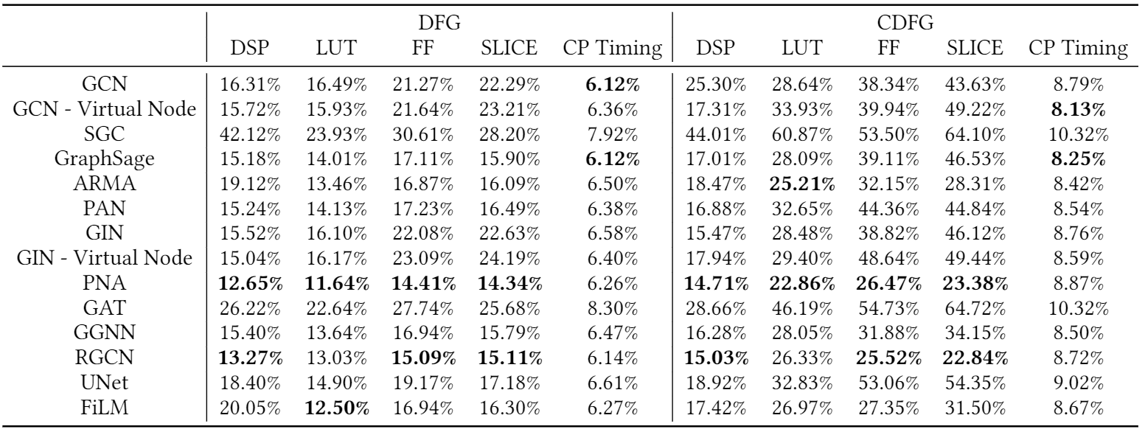
Prediction Performance on DFG and CDFG

Slide 66
Prediction Performance on DFG and CDFG
DFG v.s. CDFG

Slide 67
Prediction Performance on DFG and CDFG

Slide 68
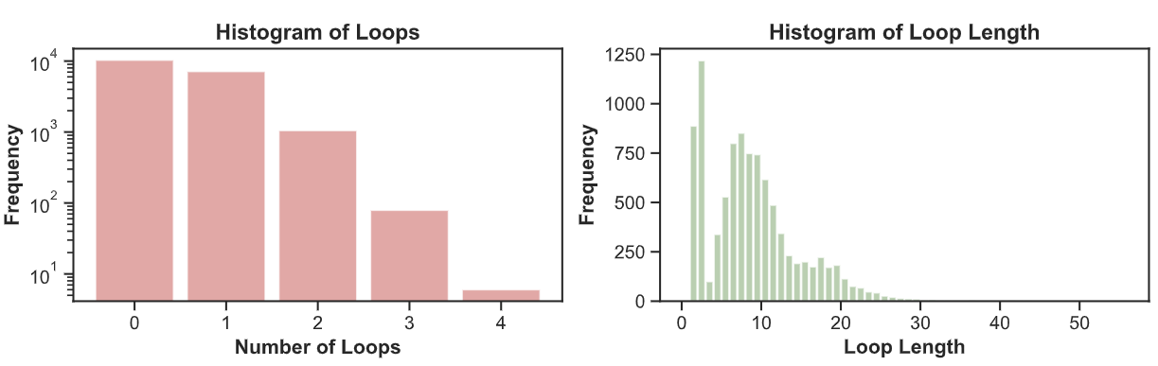
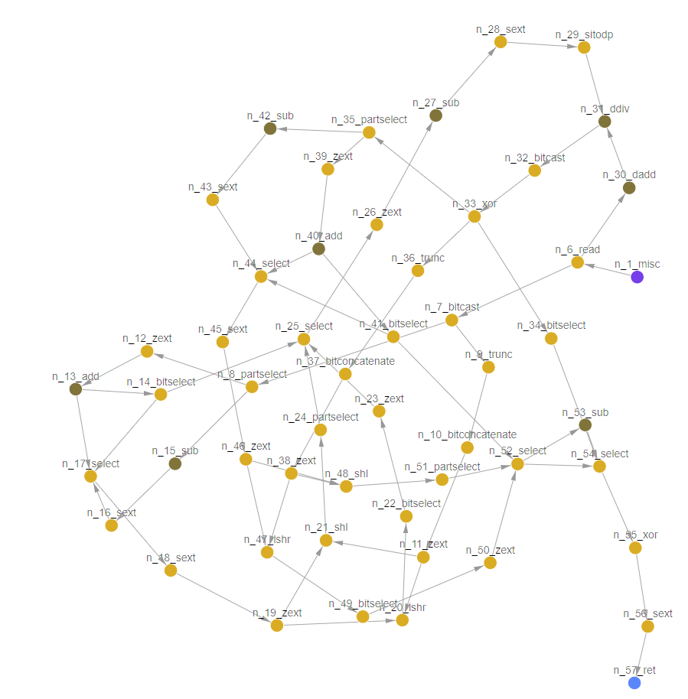
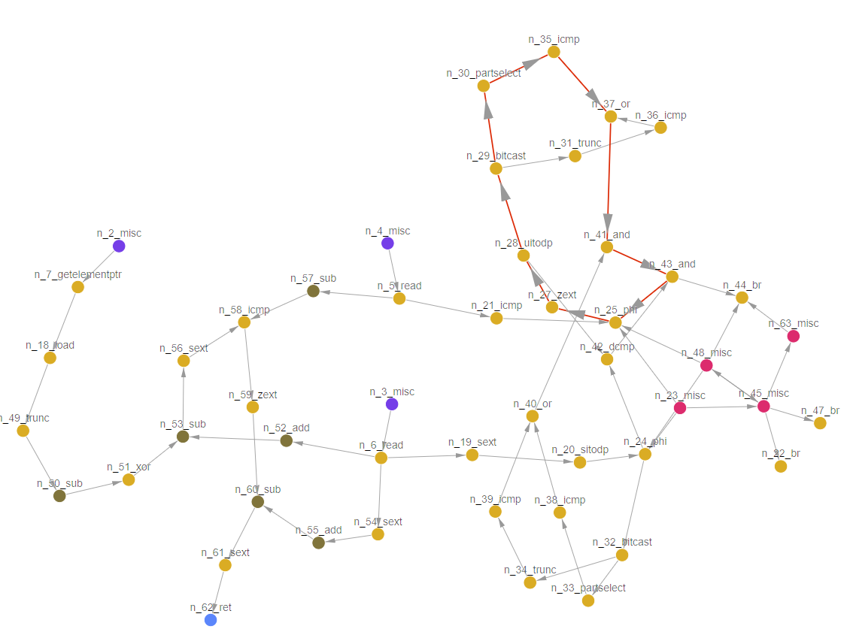
Discussions (1): DFG v.s. CDFG
DFG v.s. CDFG
CDFG size is approximately twice as large as DFG
More difficult for graph-level regression
CDFGs has a considerable number of loops
Challenge the representation power of GNNs
Control nodes/edges introduce additional complexity
loop
Example DFG
Example CDFG

Slide 69
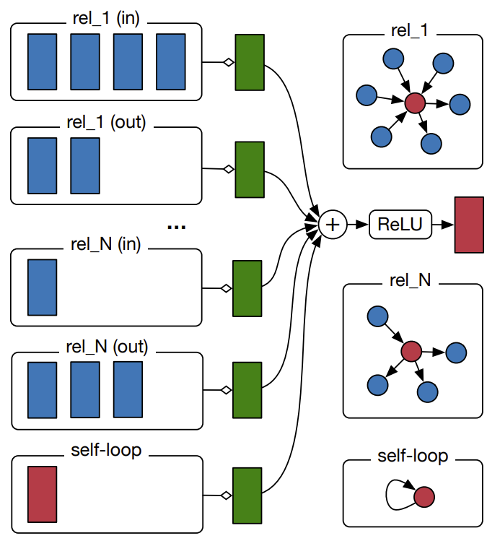
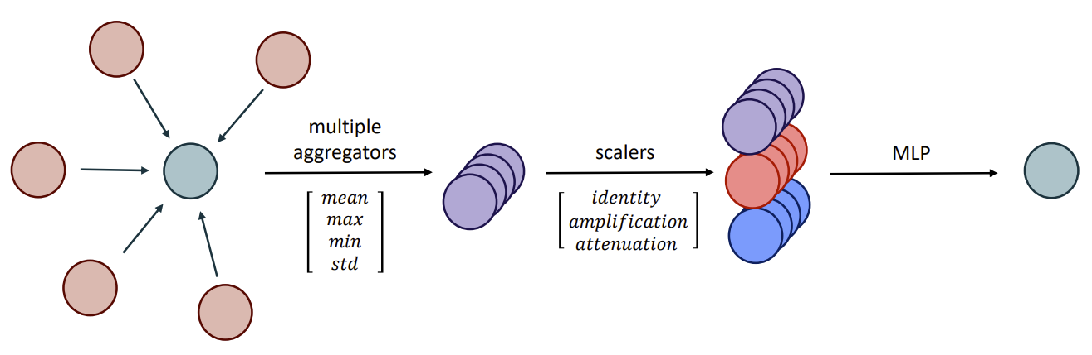
Discussions (2): GNN Model Choices
GNN Model Choices
PNA and RGCN generally show superior performance
PNA with multiple aggregators is more powerful to characterize different neighborhood information
Relational information is important in IR graphs, representing data/control dependency
Relational Graph Convolutional Network (RGCN)
Principle Neighborhood Aggregation (PNA)
Corso, G., Cavalleri, L., Beaini, D., Liò, P. and Veličković, P., Principal Neighborhood Aggregation for Graph Nets. NeurIPS, 2020
Schlichtkrull, Michael, et al. "Modeling relational data with graph convolutional networks." European semantic web conference, 2018.

Slide 70
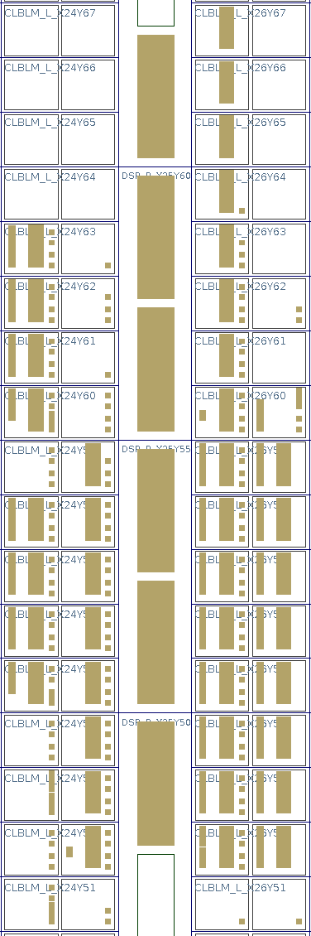
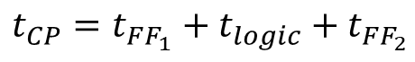
Discussions (3): Global v.s. Local Information
CP Timing: shows lower error rates and better consistency between DFGs and CDFGs
(Possibly) CP timing is insensitive to graph sizes since it captures local information between FFs
DSPs
void top_dfg(int* a, int* b, int* c)
{
*a = (*b) + 2;
int t1 = (*a) * (*b) + 4;
int t2 = t1 + (*c);
int t3 = (*b) * (t2);
*c = t1 + t2 + t3;
}
FF₁
FF₂
in
Combinational Logic
out
D
Q
D
Q
(a) Program
clk
SLICE
n2_port
$$t_{CP}=t_{FF_{1}}+t_{logic}+t_{FF_{2}}$$
n11_read
n3_port
n12_add
n1_port
Critical Path (CP): local information
Resource: global information
n16_read
n14_mul
n13_write
n17_add
n15_add
n18_mul
n20_add
n19_add
n21_write
(b) IR graph
(c) Circuit

Slide 71
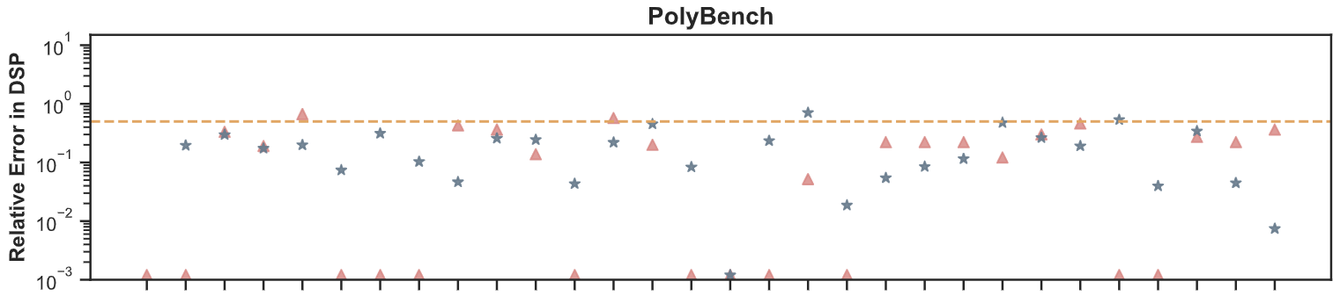
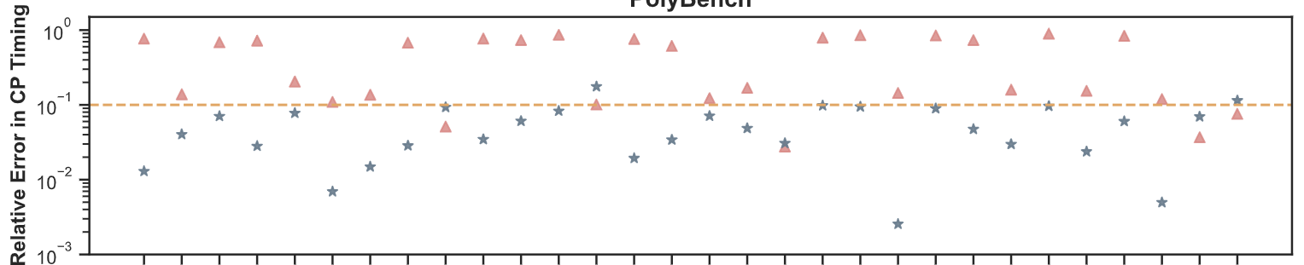
GNNs v.s. HLS
HLS Prediction
PNA Prediction

Slide 72
GNNs v.s. HLS
HLS Prediction
PNA Prediction
GNNs are slightly better in resource but obviously better in CP timing, which is hard-to-predict

Slide 73
Observed Challenges (so far…)
Generalization across graph sizes, node degrees, and out-of-distribution cases
Structural and algorithmic innovations to process heavy-loop graph topologies
GNNs are in general fragile in loops (1-WL test)
Small loops usually relate to memory operations and are confusing for resource estimation
Gap from classification to regression
Most existing GNNs are for classification (node, link, graph)
The resource/timing prediction is regression → a harder problem!

Slide 74
Outline
Background
Graph Neural Network (GNN)
Reinforcement Learning (RL)
High Level Synthesis (HLS)
HLS: Program-to-Circuit
IRONMAN: GNN-assisted design space exploration in high-level synthesis via reinforcement learning
Nan Wu, Yuan Xie, and Cong Hao, GLSVLSI, 2021
Program-to-Circuit: Exploiting GNNs for Program Representation and Circuit Translation
Nan Wu, Huake He, Yuan Xie, Pan Li, Cong Hao, arXiv, 2021
And beyond: Program-to-X
Call for future research interests ☺

Slide 75
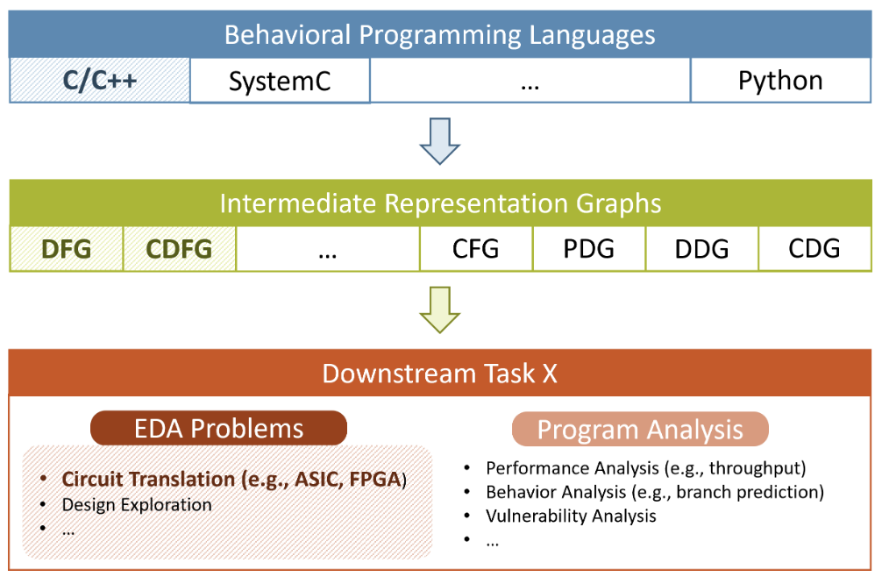
From Program-to-Circuit to Program-to-X
Program
To
Circuit
Program
To
X

Slide 76
From Program-to-Circuit to Program-to-X
GNN representation power for programs
Handling loops (very typical in programs)
Largely varied size
…
Specific GNN design for different down-stream tasks
Program analysis on vulnerability
Behavior prediction
Throughput estimation
…
Benchmark development

Slide 77
Summary & Thanks!
Discussed the power of GNN and RL in solving EDA problems, e.g., HLS
IronMan!
Discussed a more general problem, Program-to-Circuit
Hoping for more datasets, better GNNs, more domain-specific insights, etc.
The potential from Program-to-Circuit to Program-to-X
Looking forward to seeing more works!
Contact:
callie.hao@ece.gatech.edu
Sharc-lab @ Georgia Tech (https://sharclab.ece.gatech.edu/)

